Slide 1

PRESENTATION
TO THE
Quad County Fire Chiefs Association
August 25, 2026

Slide 2
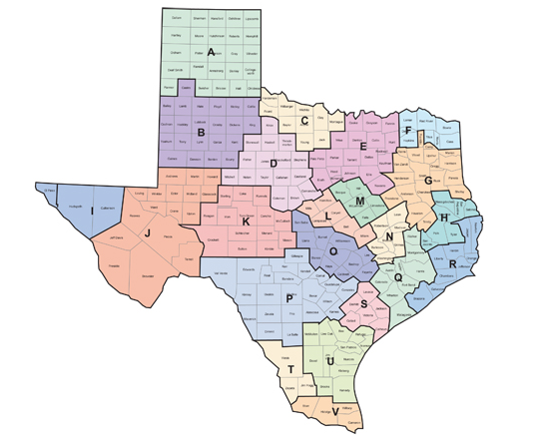
Regional Advisory Councils (RAC)
Texas has 22 Trauma Service Areas (TSA)
NCTTRAC represents TSA-E:
  19 Counties in North Central Texas (NCT)
  8,857,701* people in TSA-E
  28% of the Texas population
  2.4% of the U.S. population
  38 U.S. states have fewer total residents than DFW; only 6 states have a smaller land area.
*Reference: Texas Demographic Center (2023 statistics)

Slide 3


Regional Advisory Councils (RAC)
Legislated in 1989 by Texas Administrative Code§Rule 157.123
  Value of RACs:
    Regional Coordination – uniting and creating cohesive systems of care
    Systemwide Preparedness & Response – planning, training, & leading drills
    Data-Driven Improvement – identifying trends, gaps, & best practices
    Resource Optimization – real-time crisis coordination & resource sharing (24/7 Duty Phone)
    E. Advocacy & Representation – serving as a trusted voice for policy changes, funding, and system improvement
NCTTRAC’s Mission:
To promote and coordinate a system of quality trauma, acute, and emergency healthcare and preparedness in North Central Texas
Serves as “Switzerland” for emergency healthcare agencies and facilities to discuss, develop, and share best practices…

Slide 4

Regional Advisory Councils (RAC)
“TSA” is the geography, and the “RAC” is the members
NCTTRAC Members & Partners:
  250+ Air / Ground EMS Providers and EMS First Responders
  150+ Hospitals (23% of the state’s hospitals)
    120 Total Hospital Preparedness Program Hospitals
    57 Trauma Centers with several “In Active Pursuit”
    51 Maternal designated hospitals
    54 Neonatal designated hospitals
    50 Stroke designated hospitals
    2 Veterans Administration Hospitals
    5 Children’s Hospitals (including Level I & II designated Trauma Centers)
65 of 80 (81%) Quad Counties Licensed EMS FDs are NCTTRAC Members

Slide 5
EMS Programs & Updates
EMS County Assistance
  Heart Safe Community
  CARES
  Prehospital Whole Blood Pilot Program
  Texas EMS Wristband Program
  Pulsara Daily Use Requirement
  Emergency Medical Task Force (EMTF)
  Ambulance Turnaround Times
  EMS Rules Updates - Coming Soon
Meetings & Membership

Slide 6
EMS County Assistance (Pass-thru) Funds
Funds allocated annually to EMS providers through the RACs
+$500K distributed/reimbursed annually to NCTTRAC EMS agencies
Must meet “Active Participation” requirements:
  Submit membership application, pay dues, approved by Board
  Submit data to EMSTR annually (you do this already)
  Meet annual Pulsara participation requirements (beginning September 2026)
  Attend 6 NCTTRAC-sponsored meetings over 3 fiscal year quarters (Sept-Aug)
What EMS items can be reimbursed?
  Equipment, supplies, vehicles, education/training, communications, etc.
Opportunities to support regional programs if donated:
  CARES, EMS Wristbands, other EMS Committee-identified & approved items

Slide 7

NCTTRAC Heart Safe Community
    Developed in 2016 with help from Chief John Glover, Highland Village FD
    Established by the Citizens CPR Foundation
    Demonstrates community commitment to “Strengthen the Chain of Survival”
    Focuses on six areas:
      Access to Emergency Care
      Emergency Medical Dispatch
      Automatic External Defibrillator (AED) Access & First Response
      Advanced Life Support
      Community Awareness, Education & Activities
      Data Collection and Review
    Submit application to NCTTRAC for review and approval
    12 cities have achieved Heart Safe Community recognition in NTX
Notes:
Access to emergency care
Emergency Medical Dispatch
AED Access & First Response
Advanced Live Support
Community Awareness, Education & Activities
Data Collection & Review

Slide 8

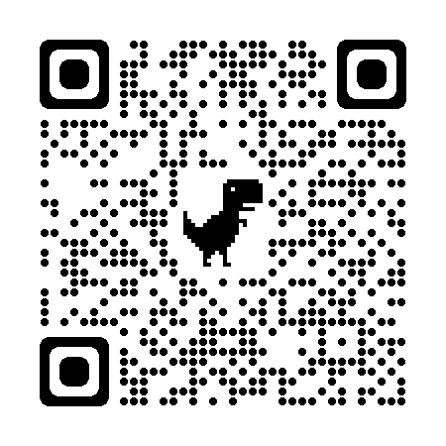
Cardiac Arrest Registry to Enhance Survival (CARES)
    Considered an indicator of a High-Performance EMS System by EMS leaders
    Provides necessary data to increase survival from Sudden Cardiac Arrest (SCA)
    MedStar & Arlington FD/AMR – CARES early Adopters & Leaders
      Followed by Plano FD, Frisco FD, and others …
    Today … 48 EMS agencies, 4.8M population coverage
    NCTTRAC EMS agencies lead Texas in CARES enrollment & participation
    Dashboards available on NCTTRAC website (ZIP Code map):
      Inform AED location/placement
      Focus public CPR education
      Target Law Enforcement involvement (AED response)
    Note: EMS/fire can significantly impact SCA survival by implementing
    Telecommunicator CPR (HB 786)
CARES Enrollment Information

Slide 9
Prehospital Whole Blood (PHWB)
Pilot Program
Purpose/Goal: To increase survival from hemorrhagic blood loss by establishing a minimum of one PHWB site in each NCTTRAC county, with priority given to EMS agencies serving the largest population
Eligibility – Must be an “Active Participant” in NCTTRAC
Must sign agreements with NCTTRAC & Blood Provider
Must have a hospital willing to rotate WB (minimize wastage)
NCTTRAC will provide Equipment, WB, training, supplies, etc.
Where are we today?
Program is available through August 31, 2027 ($1.2M)
More information - contact Lisa Ponce at lponce@ncttrac.org
Counties not currently participating in the NCTTRAC PHWB program:
Cooke
Dallas
Erath
Fannin
Hood
Hunt
Kaufman
Navarro
Palo Pinto
Somervell
Wise
LET'S GO !!!

Slide 10

Texas EMS Wristband Program
Senate Bill 500 – Statewide Project (86th Legislature)
Purpose: Provides a unique patient identifier for ALL EMS (air/ground) transports & transfers:
  Connects disparate record systems > EMS > Hospitals > Tertiary Care
  Tracks patients throughout the Continuum of Care
  Provides patient accountability during Disasters, MCIs, & Evacuations
  Required by TAC 157.126 for Trauma-designated hospitals
To be required by TAC 157.11 for EMS in March/April 2026
Available through NCTTRAC while supplies & funding last

Slide 11
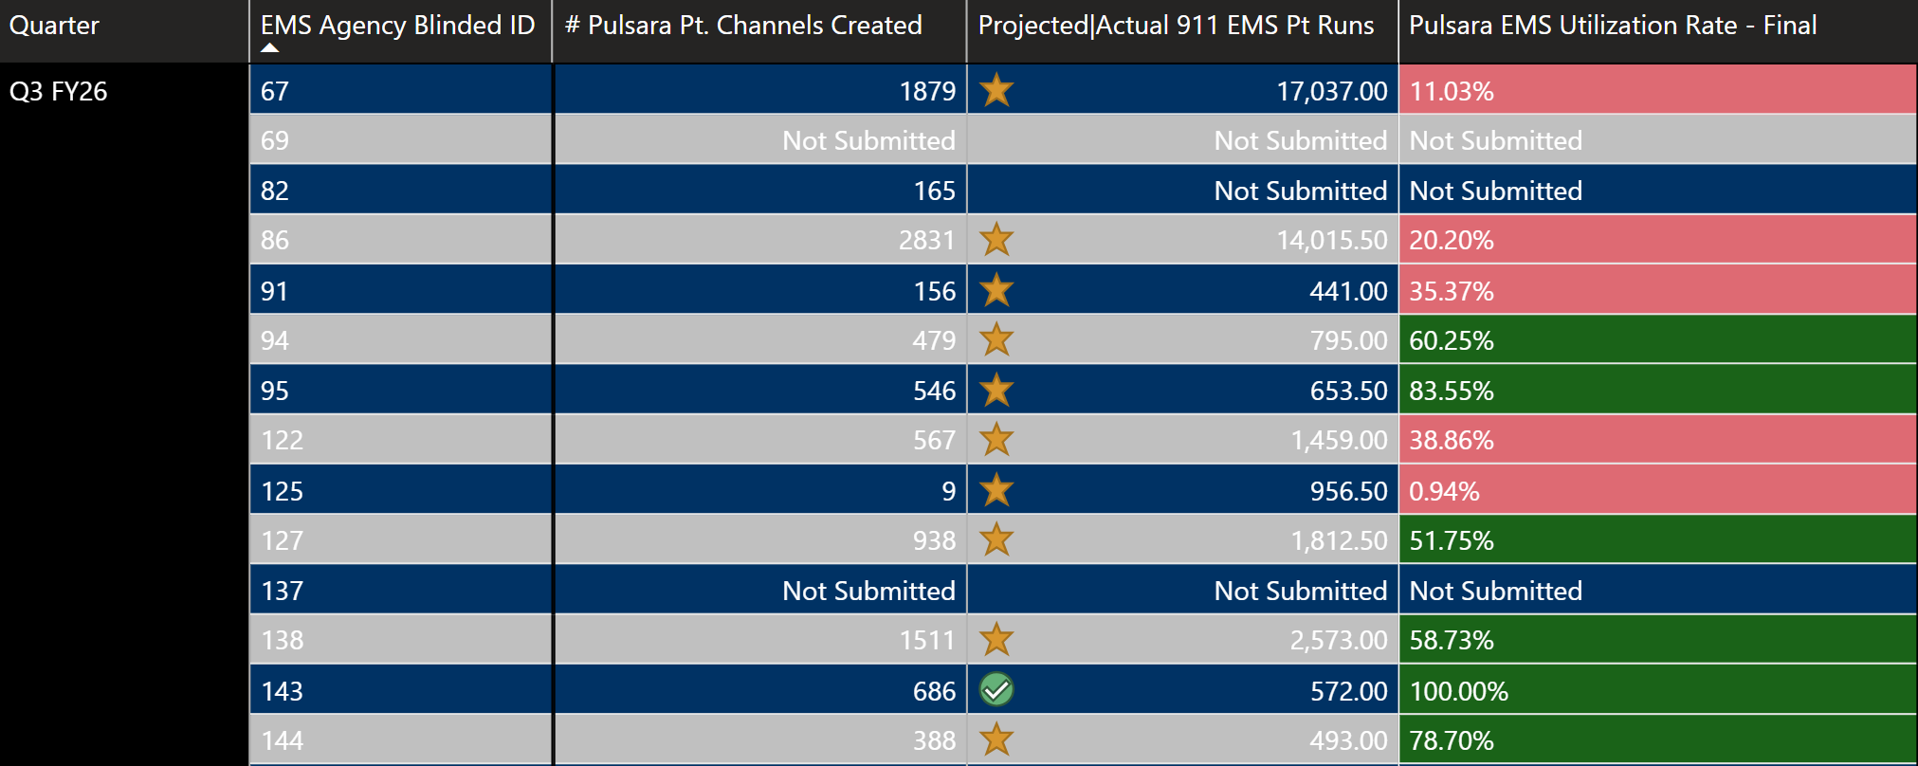
Pulsara Daily Use Requirement
Eff. 9/1/2026, Pulsara Daily Use is a NCTTRAC Active Participation Requirement
What Does This Mean?
The NCTTRAC General Membership voted to require all NCTTRAC Members to use Pulsara for prehospital-hospital patient notifications.
The General Membership and Board of Directors believe this will improve the patient handoff process and improve patient outcomes.
This requirement goes into effect starting 9/1/2026. This requirement only applies to NCTTRAC Member organizations.
How Do I Know if My Agency is Compliant?
Go to www.NCTTRAC.org and log-in
“Members” -> “Participation & Performance” -> “NCTTRAC Regional Pulsara Utilization Report”
What Does My EMS Agency Have to Do?
Use Pulsara to notify receiving hospitals about patients you are transporting to their ED.
“Each EMS Agency must create a Pulsara patient channel and share it with the receiving hospital on at least 50% of their patient transports.”
Does not apply to interfacility transfers.
What If My Agency Doesn’t Comply?
Failing to meet Active Participation requirements affects your agency’s NCTTRAC voting privileges and makes you ineligible for future EMS County Assistance funds.
Check MemberHub for your blinded ID
Icon indicates data source for # of 911 hospital transports
This # must be above 50% for 9/1/26 – 8/31/27

Slide 12
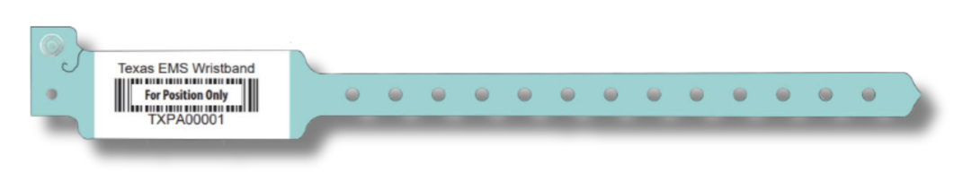
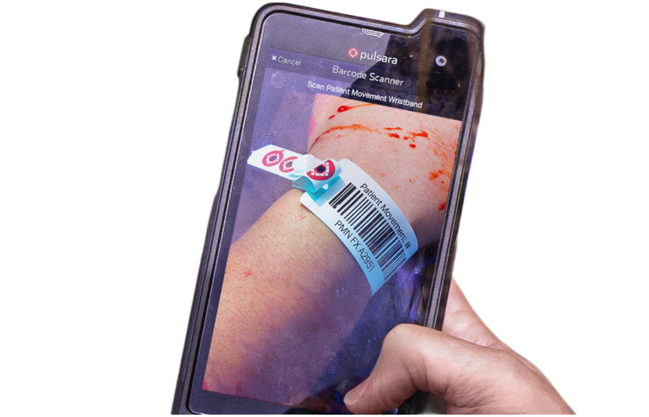
Texas Two-Step: Wristbands & Pulsara
1. TX EMS Wristband
“Texas Two-Step”
TX EMS Wristbands and Pulsara work hand-in-hand to improve patient handoff and tracking in both day-to-day and disaster settings.
For 911 EMS transports, it’s simple.
Every patient gets a wristband.
Every patient goes into Pulsara.
Band Every Patient
  See a patient without a wristband? Add one.
Scan the Wristband with Pulsara
  Newly added band = Creates new patient channel
  Existing band = Opens the existing patient channel
Daily Use
MCI/Triage
2. Pulsara

Slide 13
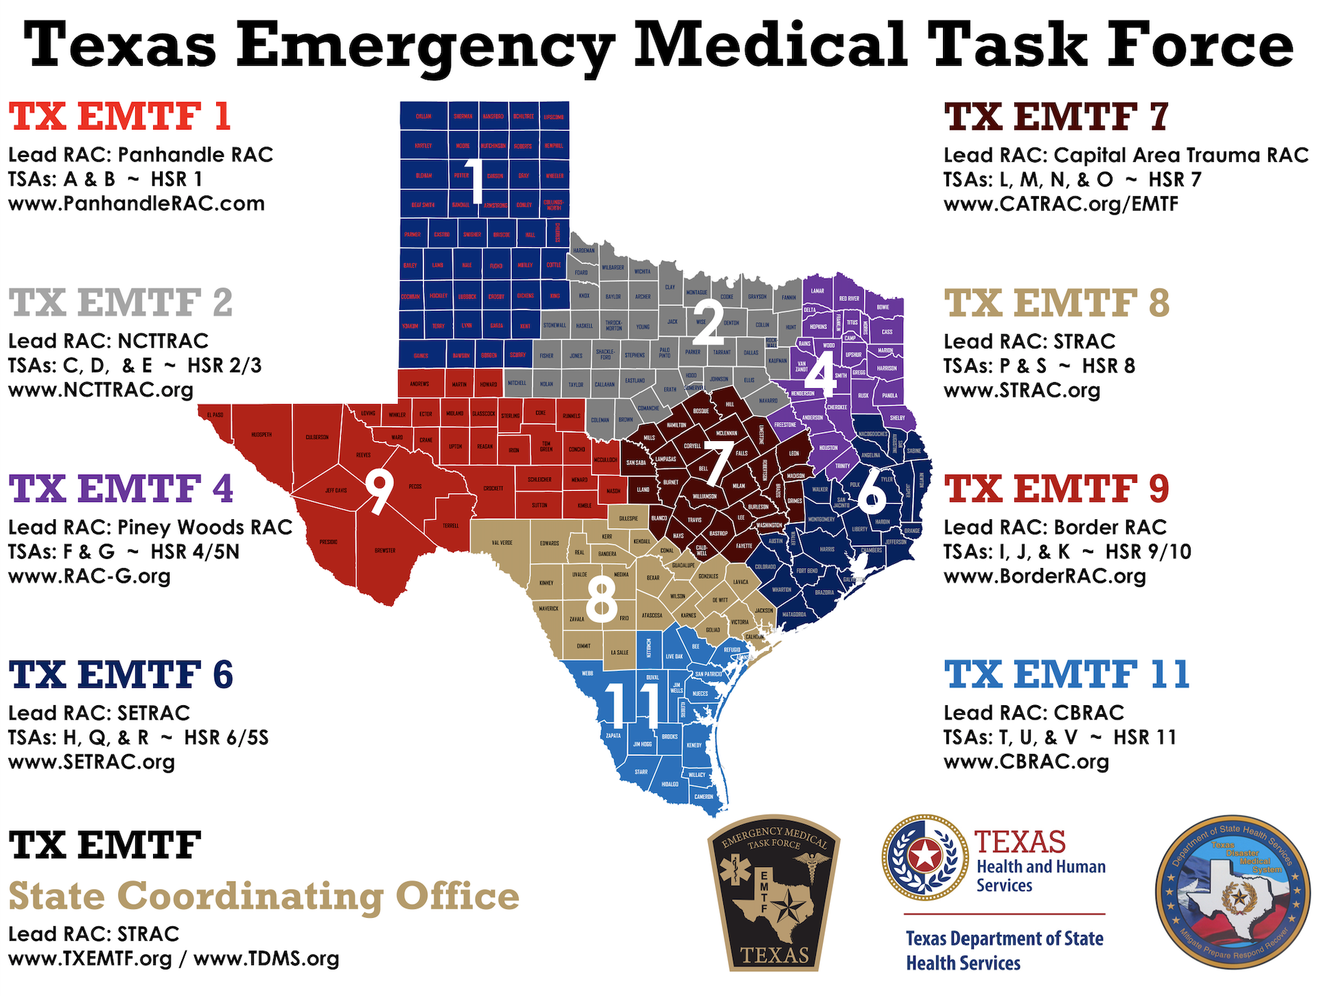
Emergency Medical Task Force (EMTF)
Quick Facts:
8 EMTF Regions – providing statewide response to disasters
13 Components:
  AMBUS (x6 in EMTF-2)
  Ambulance Strike Teams
  Wildland Fire Response
102 EMS Providers
≈30% of all personnel & assets deployed come from EMTF-2
  $5.4M reimbursed in CY 2025
  Portal-to-portal reimbursement
  90-day turnaround to receive funds
How to get involved?
  Contact Darian Shadd at dshadd@ncttrac.org

Slide 14
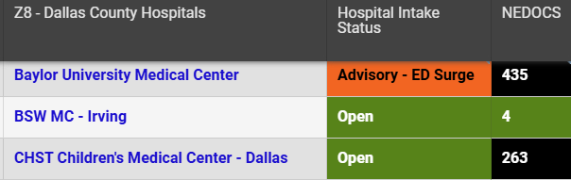
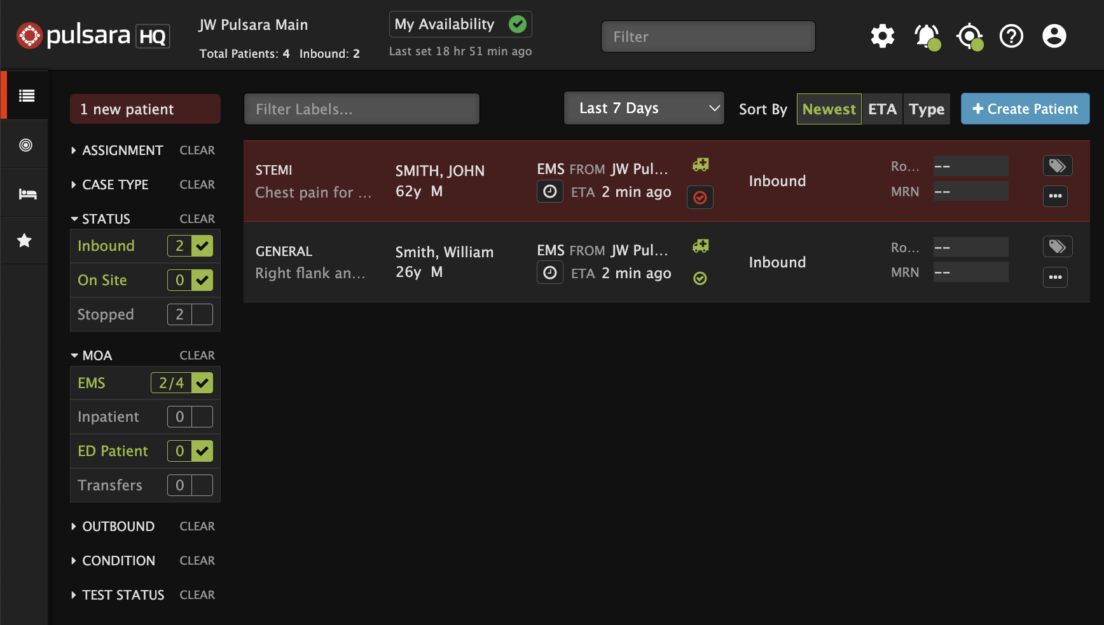
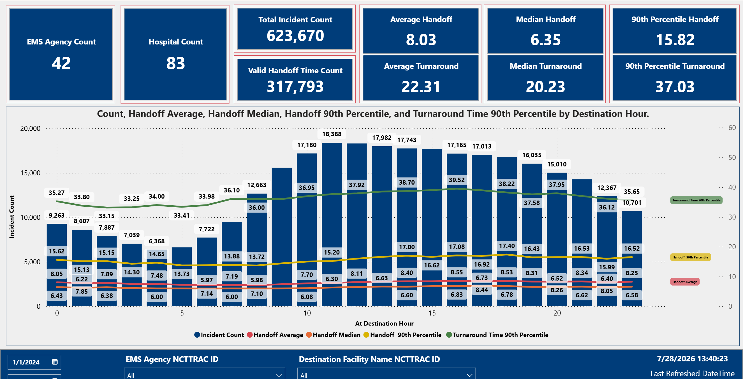
Ambulance Turnaround Times
Goal: Ambulance Turnaround Time of <25 minutes on 50% or more of all transports
Pillar 1: Destination Choice
Method: EMResource
View hospital status & inform destination facility choice
Dispatch and/or EMS Supervisors
Hospital Intake Status
  Open/Advisory/Closed
NEDOCS
  Higher # = longer offload time
Pillar 2: Prehospital Notification
Method: Pulsara
Early notification via Pulsara = faster handoff (pre-arrival patient room assignments)
Live arrival times = faster handoff (ED staff ready and waiting to receive patient)
Pillar 3: Performance Monitoring
Method: Regional Dashboard
Visible on NCTTRAC website & reviewed in EMS Committee meetings
Delineate between ‘wall times’ (hospital issue) and ‘turnaround times’ (EMS issue)
Identify top performers and provide best practices education to lower performers

Slide 15
EMS Rules Updates (Coming Soon)
Human Trafficking Prevention (HB 742): All EMS personnel must complete HHSC-approved human trafficking education.
Active Shooter Planning (HB 33): Cited as the Uvalde Strong Act; EMS providers are required to participate in school-based active shooter exercises and training when invited by local school districts or law enforcement.
AI Disclosure (HB 149): Providers using AI for treatment decisions (not just documentation) must have a formal policy in place and notify patients.
Peer Support Protections (HB 35): Participation in peer support programs is protected; DSHS will not take disciplinary action against individuals for seeking help through these programs.
Military & Veteran Licensing (SB 1818): Expedites licensing for veterans and military spouses, allowing them to practice for up to three years under out-of-state licenses in certain conditions.
Stalking Disqualification (SB 1021): A conviction for stalking after September 1, 2025, may lead to the disqualification of EMS certification.

Slide 16
EMS Rules Updates (Coming Soon)
Medical Director Authority: Rules have been clarified to explicitly state the Medical Director’s authority over protocols, clinical guidelines, and the ability to "de-credential" individuals from working under their license.
Texas EMS Wristband Program (RAC): Participation in the Texas EMS wristband initiative will be mandated to improve patient tracking during daily operations and mass casualty incidents.
Skills Verification: DSHS is removing the requirement for state-level skills verification for renewals, shifting this responsibility entirely to the Medical Director and EMS provider.

Slide 17
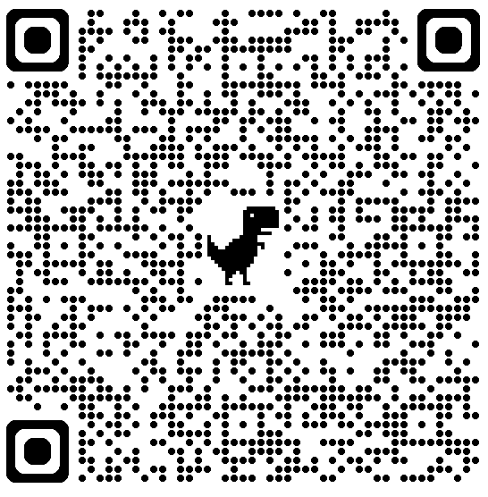
Come join us …
Annual General Membership Meeting
When: September 15, 2026 12:30 PM
Where: Hilton Garden Inn Grand Prairie at EpicCentral
Join Us For Use QR Code to Register
Member Awards and Recognition
Continuing Education Hours
Looking Ahead at FY27
Prize Raffle
Networking Lunch
Financial Review
Monthly Recurring Meetings
(Check Website Calendar at https://ncttrac.org/calendar/ for registration info)
First Tuesday | First Wednesday | First Thursday | Second Tuesday | Second Thursday
EMTF Subcommittee 8:30 AM | Cardiac Committee 8:00 AM | Air Medical Committee 9:00 AM | Board of Directors 10:00 AM | Perinatal Committee 8:00 AM
 | EMS Committee 9:00 AM | Pediatric Committee 10:30 AM
Regional Emergency Preparedness Committee (REPC) 10:30 AM | Stroke Committee 10:30 AM | Trauma Committee 1:00 PM | EMS Medical Directors Committee (Quarterly)
 | ED Operations Committee 1:00 PM
Time | Event
9:00 - 10:00 AM | Continuing Education #1: Strauma
10:30 - 11:30 AM | Continuing Education #2: Kids On Board – Improving Pediatric Transport Practices
11:30 AM - 12:15 PM | Networking Lunch
12:15 – 12:30 PM | Keynote Speaker: Chief Padilla (Arlington FD)
12:30 - 2:30 PM | General Membership Meeting
Interested in becoming a NCTTRAC Member? Email Admin@NCTTRAC.org to get started!

Slide 18
Questions?
Jim Dickerson,
Executive Director
jdickerson@ncttrac.org
Jacob Seil
Deputy Executive Director
jseil@ncttrac.org

